Slide 1
LECTURE 6b
The U-net convolutional neural network
Imaging with multimode fibers

Slide 2

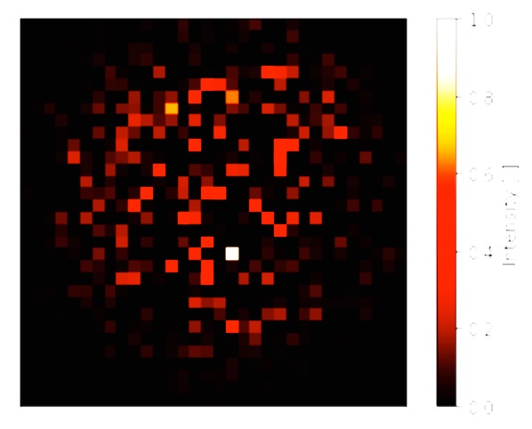
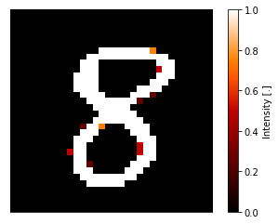
Hetero-associative encoder-decoders
Map/translate an input image to a different representation Learn and localise features in the input image and map them to the output
Notes:
. Dimension reduction, feature vectors

Slide 3
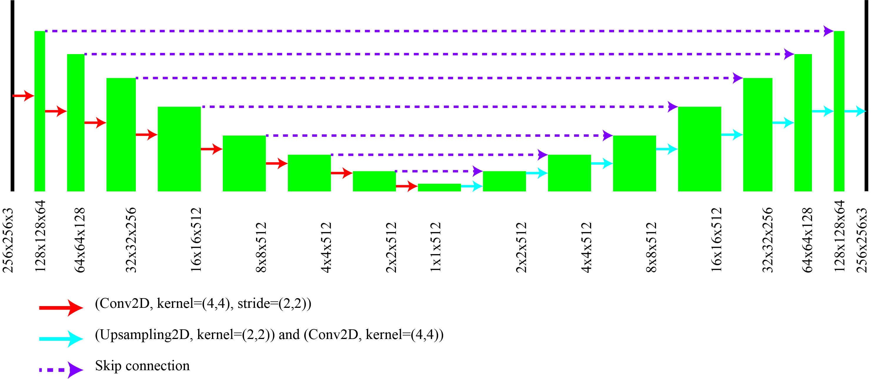
Unet
Activation function: LeakyReLU
Cost function: Mean squared error
Optimizer: ADAM
Learning rate: 0.0002
Final layer activation function: tanh
Training samples: 400
Batch size: 106
Images are normalized to values between -1 and 1

Slide 4
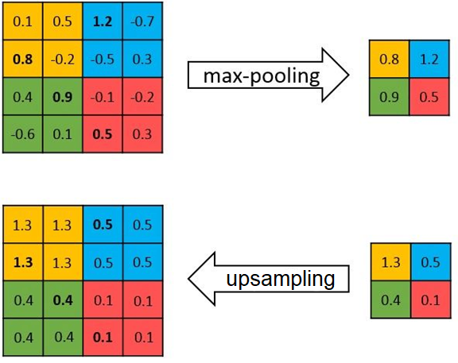
U-net CNN architecture

Slide 5
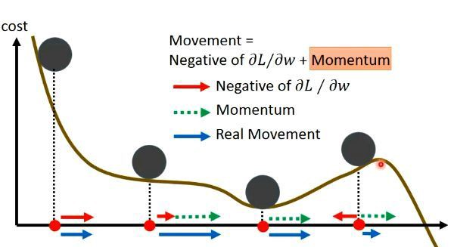
Momentum (and ADAM)
λ is decay factor and it is between 0 and 1.
Picture is from li hongyi, one day understanding deep learning
Notes:
The momentum m keeps the weights changing even when dC/dw is zero. In this way we don’t get stuck in local minima. If we are in a big valley, then dC/dw =0 for a long time and the effect of the momentum dies. Lambda<1 . For Adam we have the momentum tern approximately, but also its effect is modulated by the 1-beta to the t+1 term. The v term contains (dC/dw)2 which makes v BIG when we are in a steep slope. Since v is in the bottom and therefore it deactivates the effect of the momentum when we are not near the bottom the valley. Since we need the momentum to avoid getting stuck in locat minima, this can be good.

Slide 6
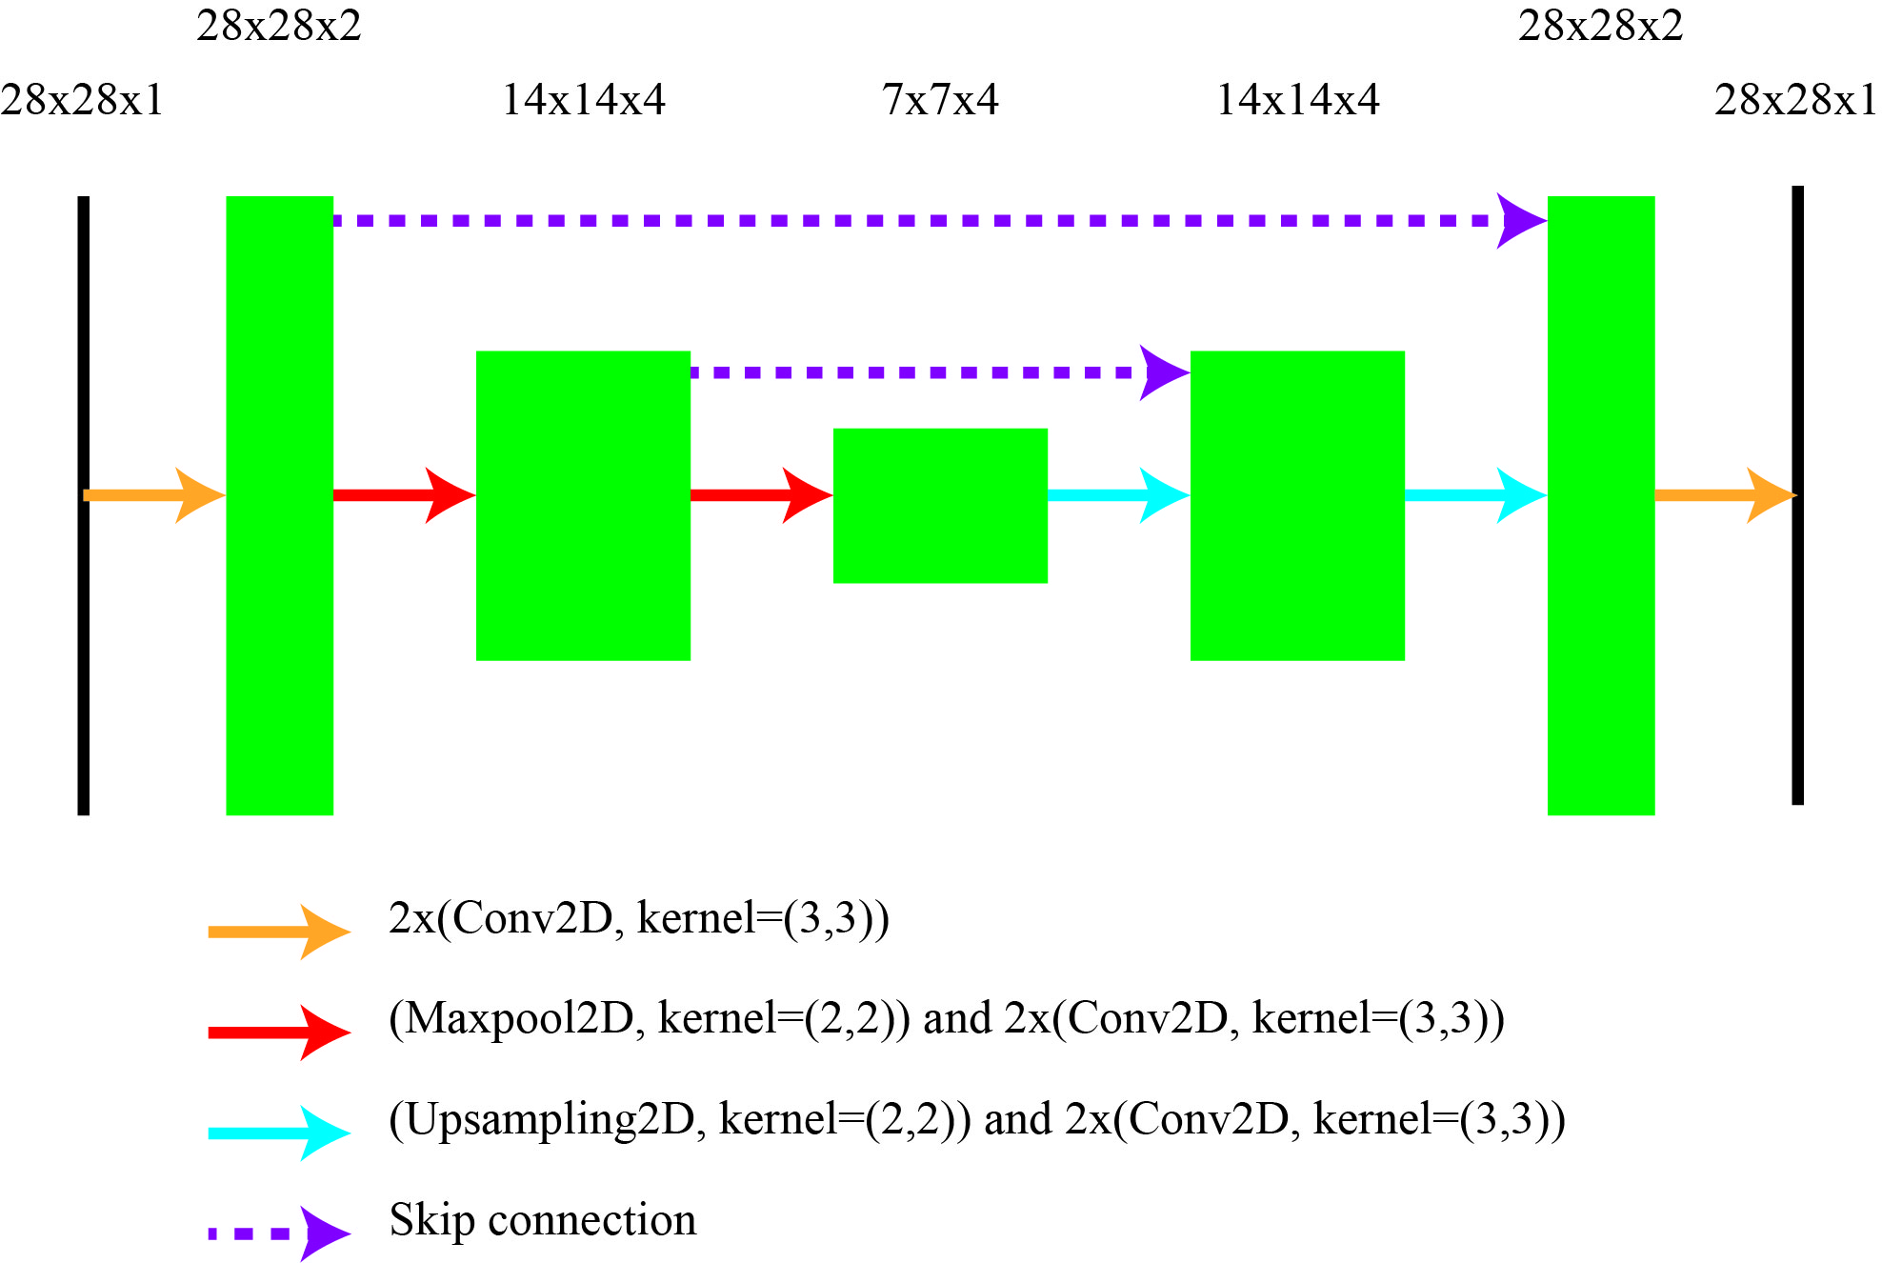
Unet: Digit unblurring
Input
Target
Activation function: LeakyReLU
Cost function: Mean squared error
Optimizer: ADAM
Learning rate: 0.0001
Final layer activation function: tanh
Training samples: 60000
Batch size: 1000
Images are normalized to values between -1 and 1

Slide 7
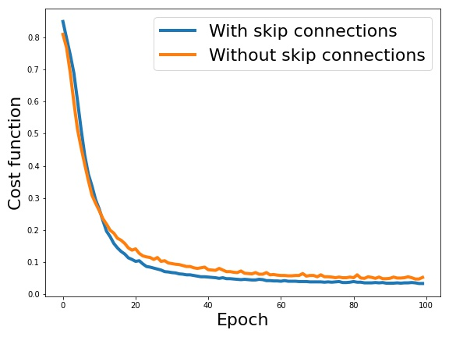
Unet: Digit unblurring
Test results
Input
Target
Without skip connections
With skip connections
Cost function: Mean squared error

Slide 8
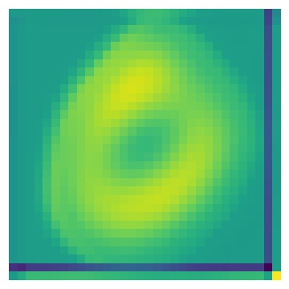
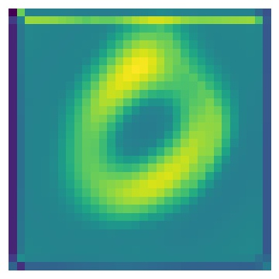
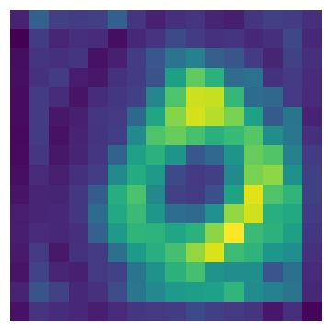
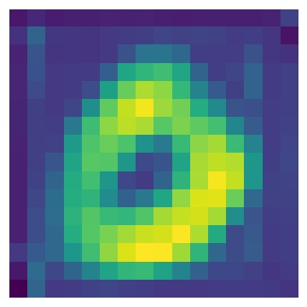
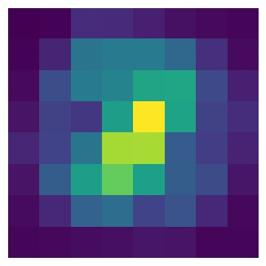
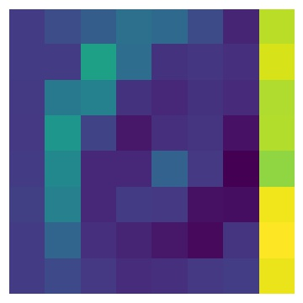
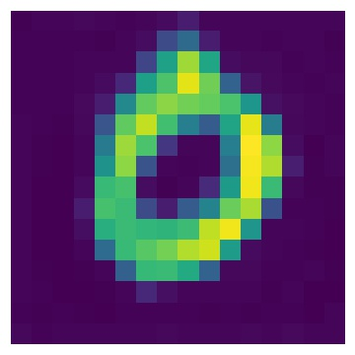
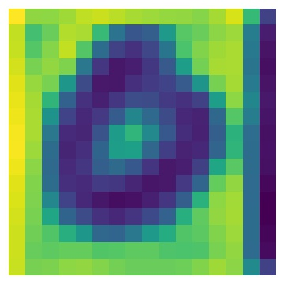
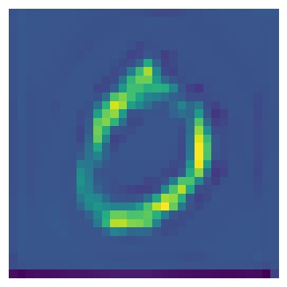
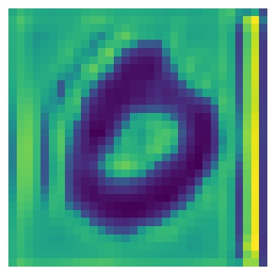
Unet: Digit unblurring – output of hidden layers
With skip connection
Without skip connection
1
2
1
2
3
4
5
3
4
5

Slide 9
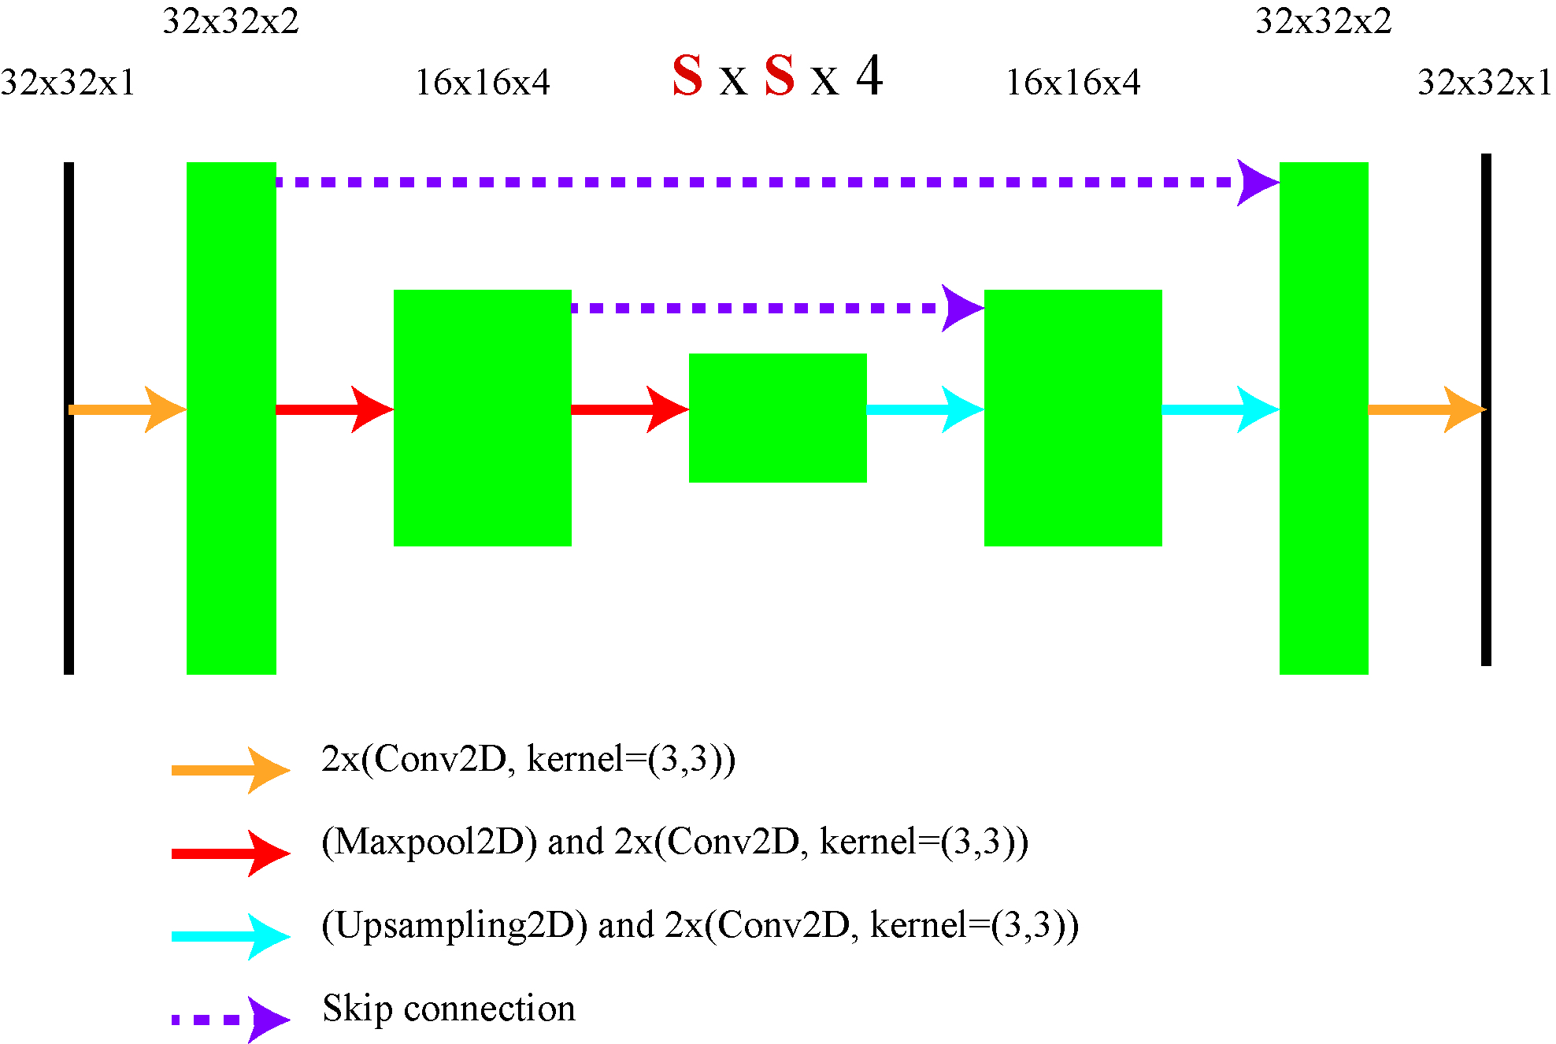
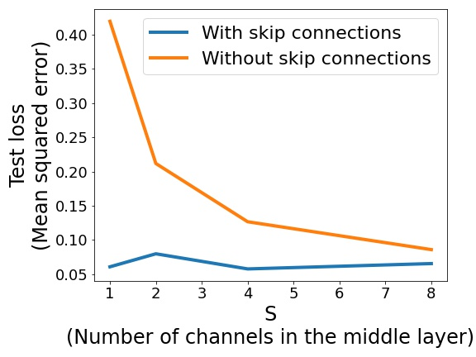
Unet: with and without skip connections
S: Number of channels in the middle layer
Changing S from 1 to 8
Activation function: LeakyReLU
Cost function: Mean squared error
Optimizer: ADAM
Learning rate: 0.0001
Final layer activation function: tanh
Training samples: 60000
Batch size: 1000
Images are normalized to values between -1 and 1

Slide 10
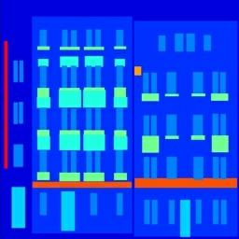
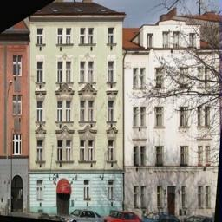
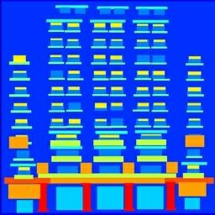
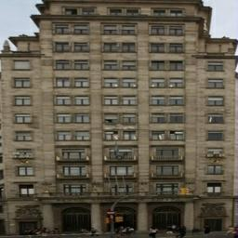
Unet: Facade Dataset
Dataset:
400 training samples
106 test samples
Image size: 256x256x3

Slide 11
Unet: Facade Dataset
Activation function: LeakyReLU
Cost function: Mean squared error
Optimizer: ADAM
Learning rate: 0.0002
Final layer activation function: tanh
Training samples: 400
Batch size: 106
Images are normalized to values between -1 and 1

Slide 12
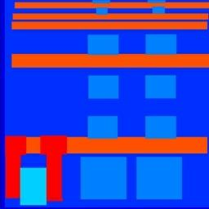
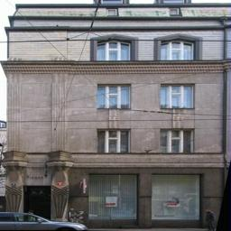

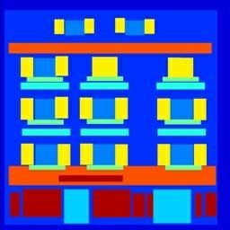
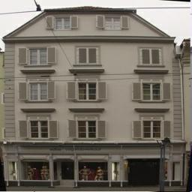
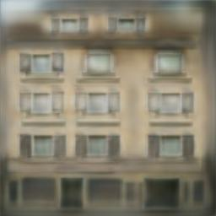
Unet: Facade Dataset
Input
Target
Network output

Slide 13
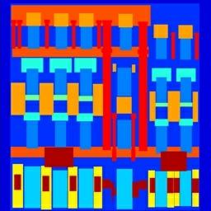
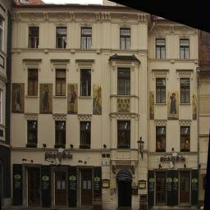
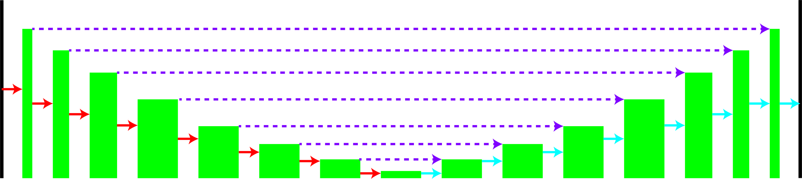
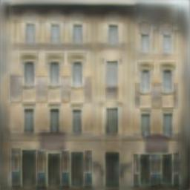
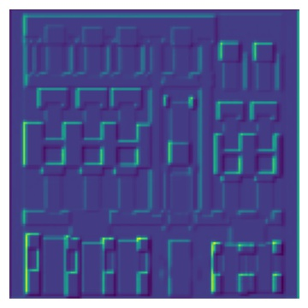
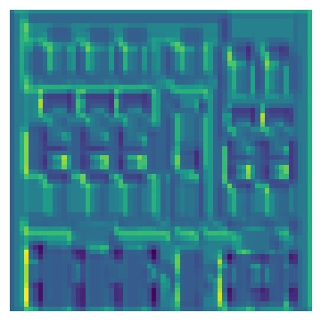
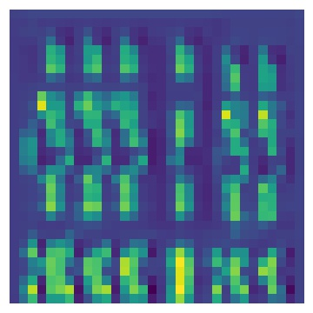
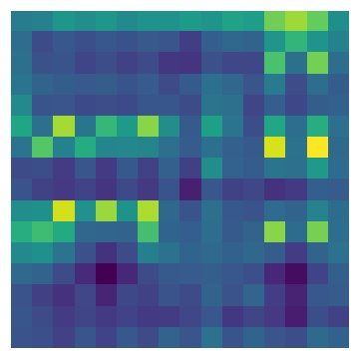
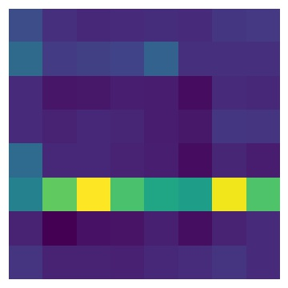


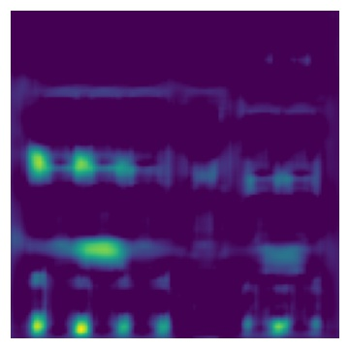
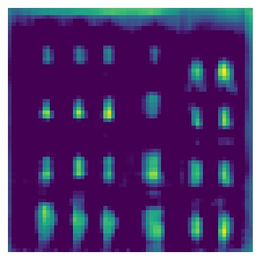
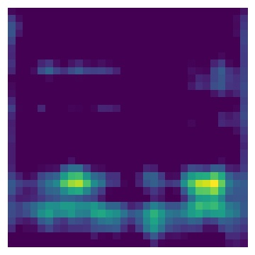
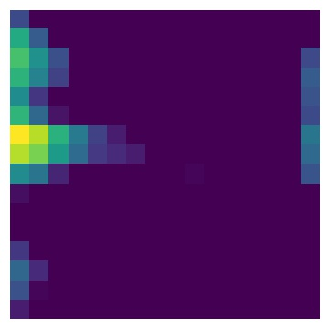
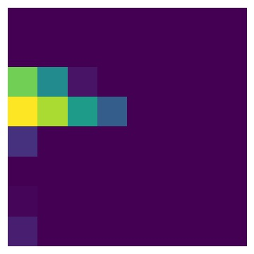


Input
Target
Unet: Facade Dataset
Network output
1
2
3
6
8
9
10
11
13
4
5
7
12
14
1
2
3
4
5
6
7
14
12
13
11
10
9
8

Slide 14
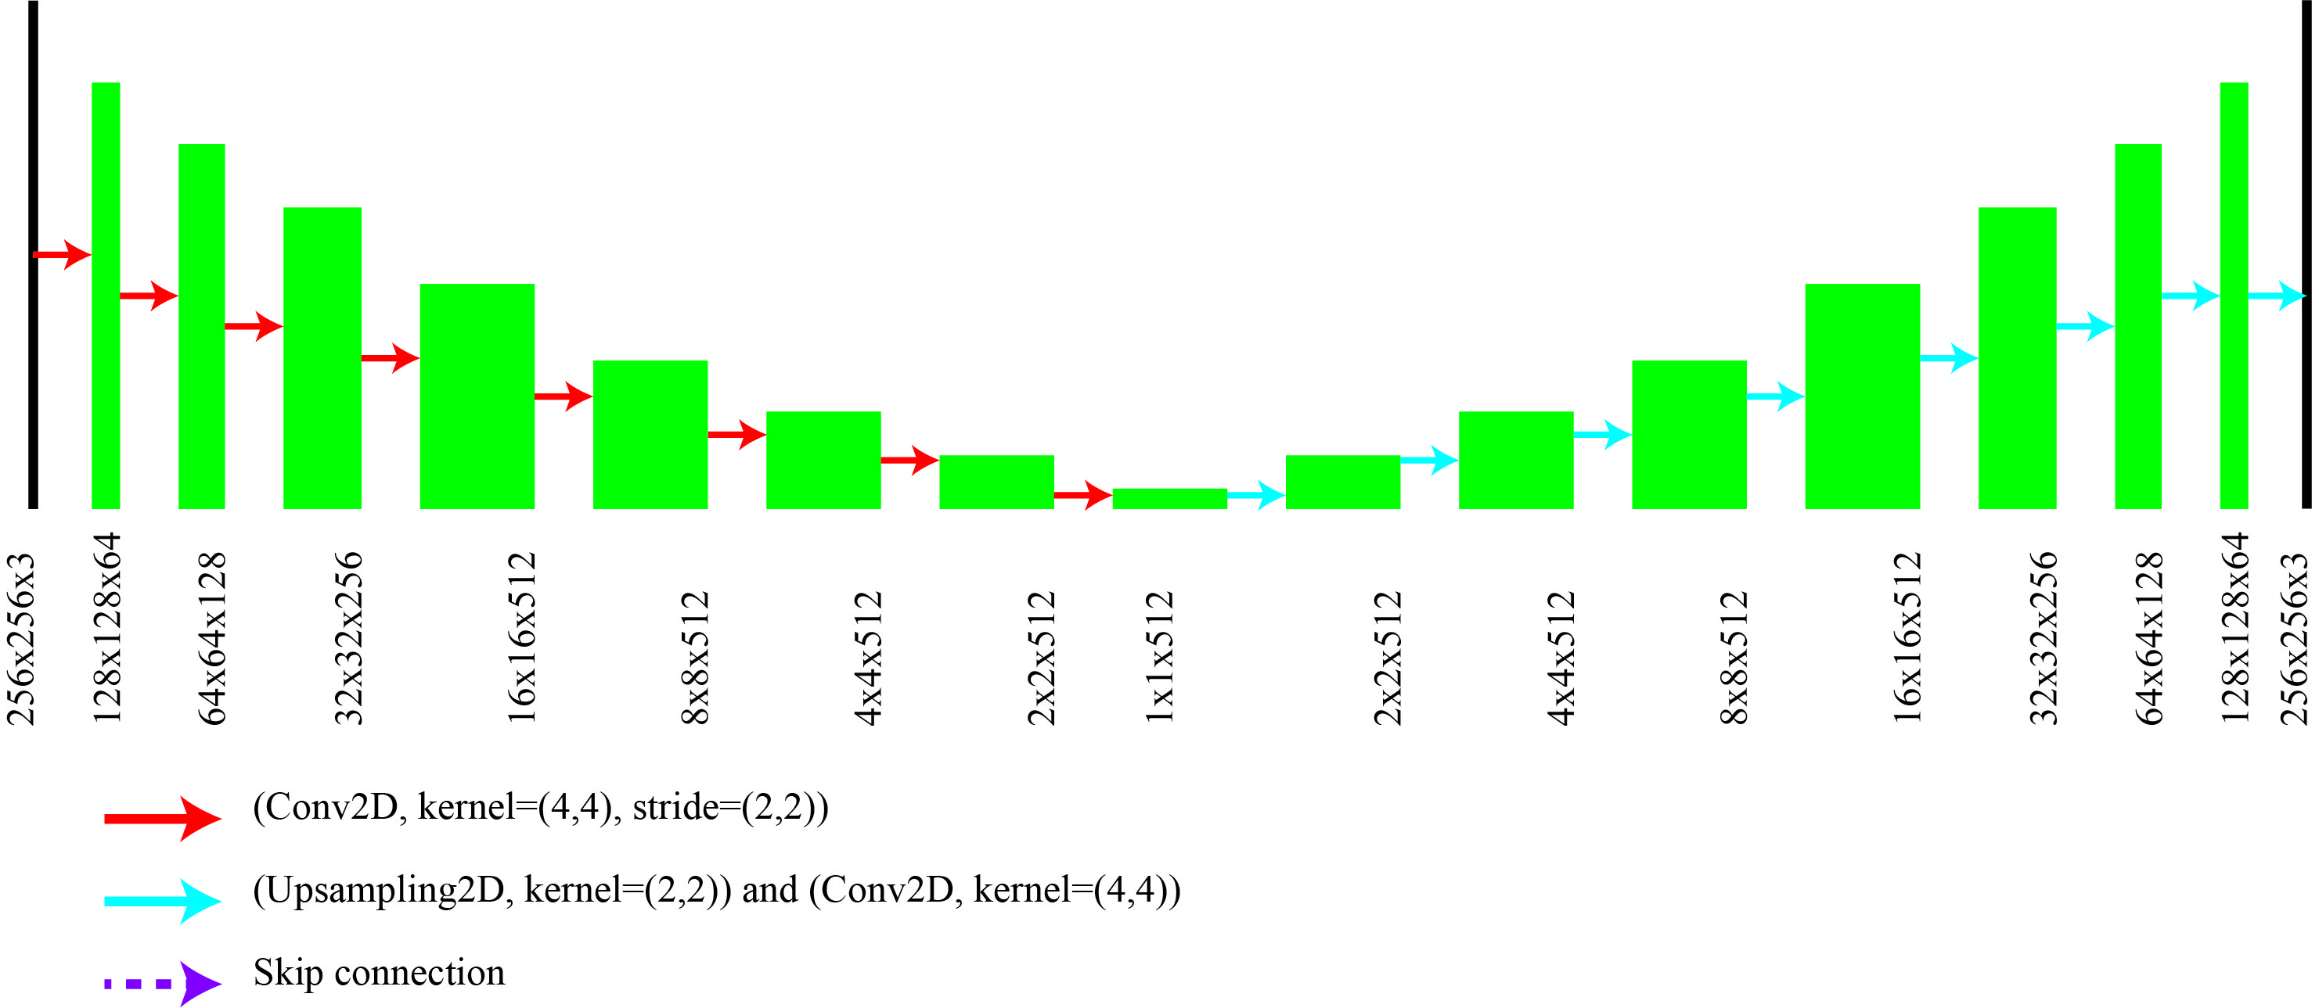

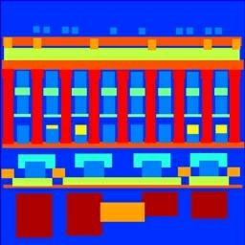
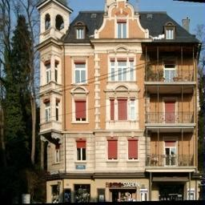
Unet: Facade Dataset - Without skip connections
Input
Target
Network output
Input
Target
Network output
Two examples

Slide 15
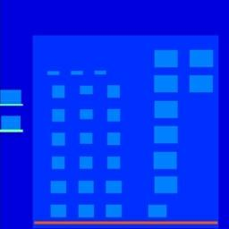
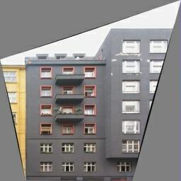
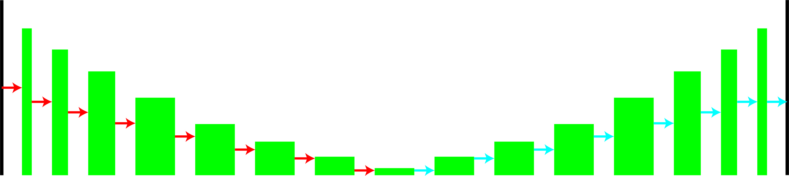
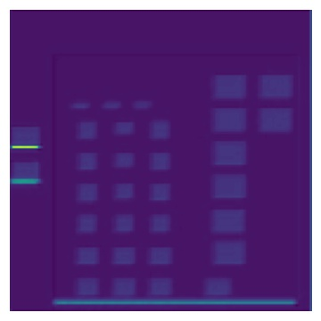
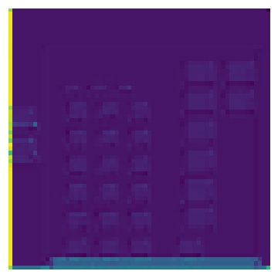









Input
Target
Unet: Facade Dataset
Without skip connections
Network output
1
2
3
6
8
9
10
11
13
4
5
7
12
14
1
2
3
4
5
6
7
14
12
13
11
10
9
8

Slide 16
Input
Target
Unet: Facade Dataset
Network output
1
2
3
6
8
9
10
11
13
4
5
7
12
14
1
2
3
4
5
6
7
14
12
13
11
10
9
8
Hidden layers representations

Slide 17



Light propagation in multimode fibers (MMF)
Multimode
fiber
Notes:
The object at every distance z can be represented as a linear combination of the modes supported by the MMF. In the ideal case this alfa does not change in z, but what generated this speckle then?

Slide 18



Imaging through multimode fibers
Microscope
objective
Multimode
fiber
Multimode
fiber
Microscope
objective

Slide 19


Interpretation input images through intensity detection
Speckle pattern at the distal end
SLM input image
Notes:
If we would want to transfer an image through a mmf we would see that the output is a speckle field. When light couples….

Slide 20










Handwritten digit recognition

Slide 21















Information content of the distal speckle patterns
Difference between output speckle patterns
SLM input
Distal speckle pattern

Slide 22


Information content of the distal speckle patterns
Difference between output speckle patterns
SLM input
Distal speckle pattern

Slide 23

Pattern classification
0
1
2
3
4
5
256 kernels
6
128 kernels
7
8
64 kernels
9
32 kernels
Can we recognize the digits by looking at a speckle pattern of a 2cm long GRIN fiber?

Slide 24

Pattern classification
0
1
2
3
4
5
256 kernels
6
128 kernels
7
8
64 kernels
9
32 kernels
Can we recognize the digits by looking at a speckle pattern of a 2cm long GRIN fiber?

Slide 25


Pattern classification
SLM input image
Phase input pattern
N. Borhani, E. Kakkava, C. Moser, and D. Psaltis, "Learning to see through multimode fibers," Optica, OPTICA 5, 960–966 (2018).

Slide 26
Pattern classification
SLM input image
Phase input pattern
Avarage classification accuracy: 97%
N. Borhani, E. Kakkava, C. Moser, and D. Psaltis, "Learning to see through multimode fibers," Optica, OPTICA 5, 960–966 (2018).

Slide 27




Image reconstruction
N. Bohrani, E. Kakkava,C. Moser, D. Psaltis
Learning to see through mutlimode fiber, arXiv, 2018
Effect of fiber length
0.01 - 1 km
RECONSTRUCTION NETWORK
OUTPUT
INPUT
Notes:
# examples – number of weigths

Slide 28


Image reconstruction
Training with handwritten
digits

